Slide 1
Final lecture of MSKCC Biostatistics Class
Six Simple Statistical Slip-ups (and how to avoid them)

Slide 2
Perhaps the only slip up you need to avoid
Not having a statistician

Slide 3
You don’t need a statistician
Statistics is essentially a straightforward issue of using computer software and can be done by a reasonably intelligent amateur

Slide 4
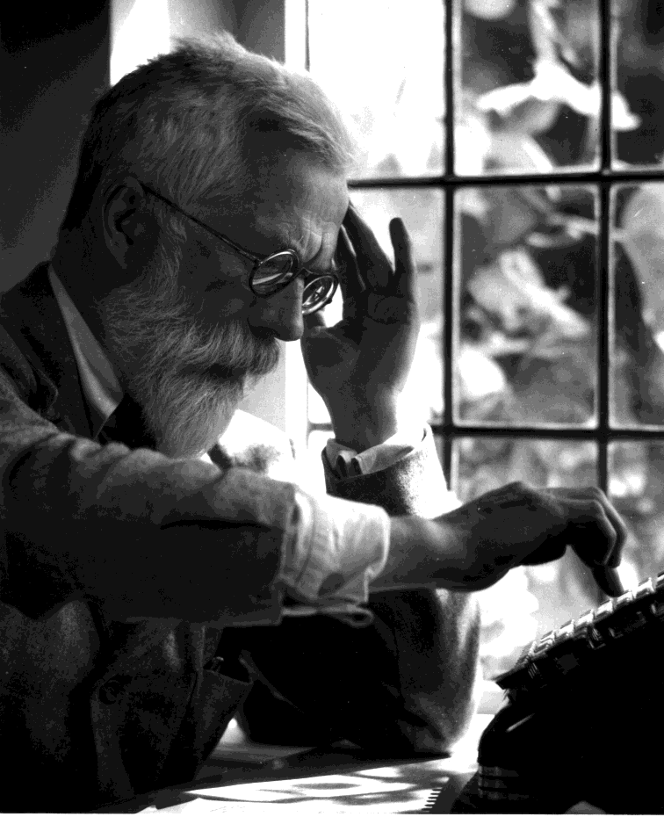
Doing it yourself
Only recently possible

Slide 5
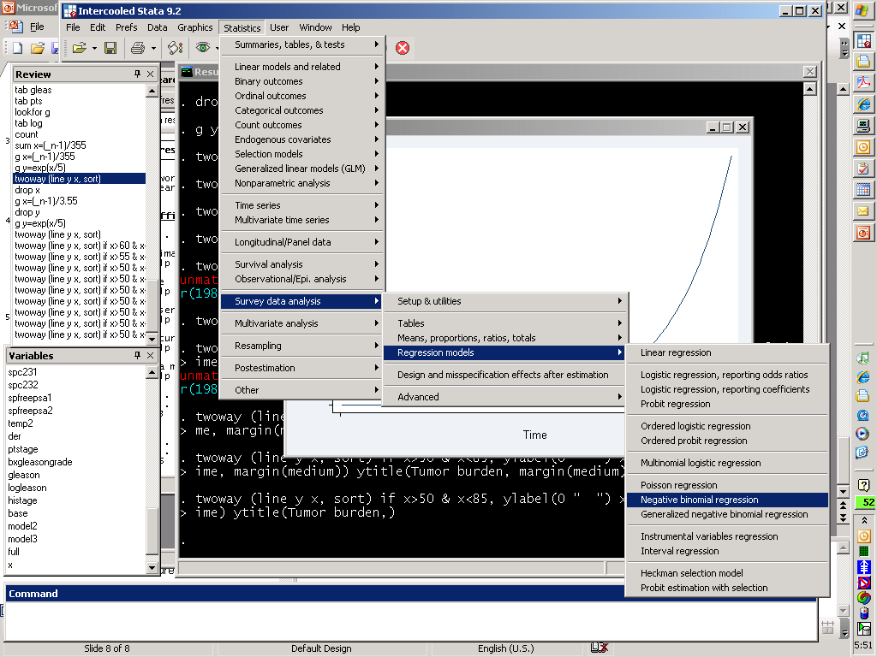

Slide 6
How to do statistics like a real clinician
Statistician: "Oh, so you have already calculated the P value?"
Surgeon: "Yes, I used multinomial logistic regression."
Statistician: "Really? How did you come up with that?"
Surgeon: "Well, I tried each analysis on the SPSS drop-down menus, and that was the one that gave the smallest P value".

Slide 7
Doing statistics yourself
… can be ok, if you are very careful about it
You have to know your limitations
But this isn’t straightforward at all

Slide 8
Biggest problem with DIY statistics
What you get is a number. How do you know it is the right one?
Computers will do the silliest things

Slide 9
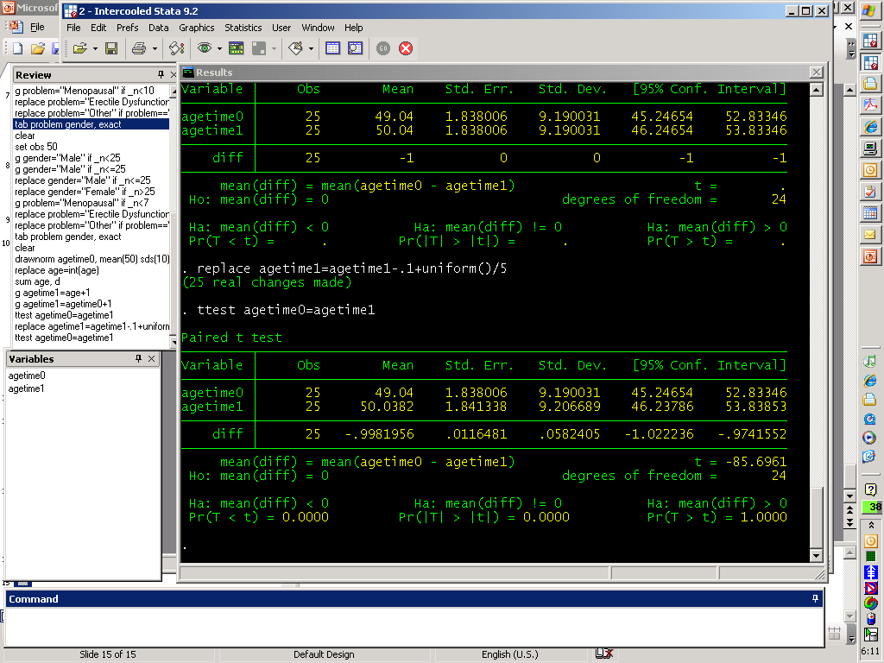

Slide 10
Biostatistics
Math

Slide 11
Biostatistics
Biology
Math
Biology

Slide 12
Biostatistics
Biology
Math
Biology
Computers won’t help
Computers help
Computers won’t help

Slide 13
Also….
The math ain’t that easy.

Slide 14
Anesthesia literature
9% of the 722 descriptive statistics had major errors
78% of inferential statistics had errors

Slide 15
An experiment
Let’s choose the first paper from the Journal Urology
Who did the stats?
Were they any good?

Slide 16
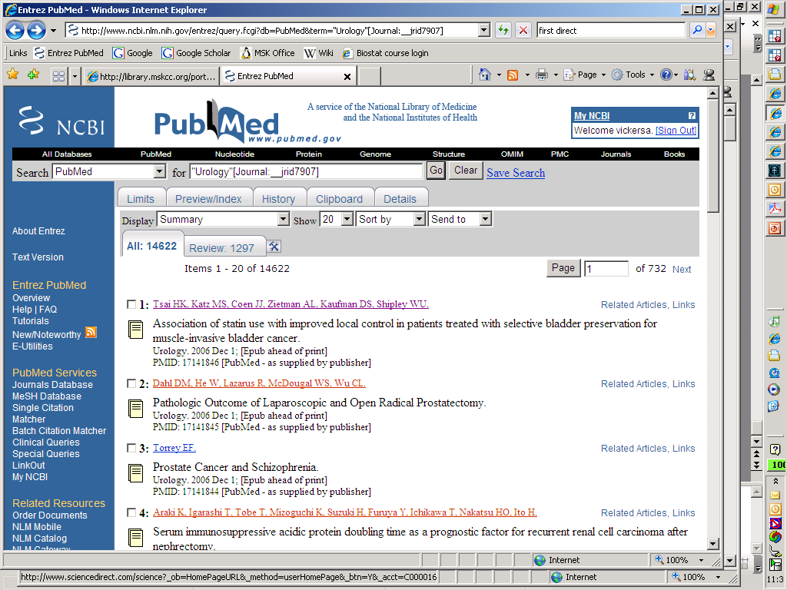

Slide 17
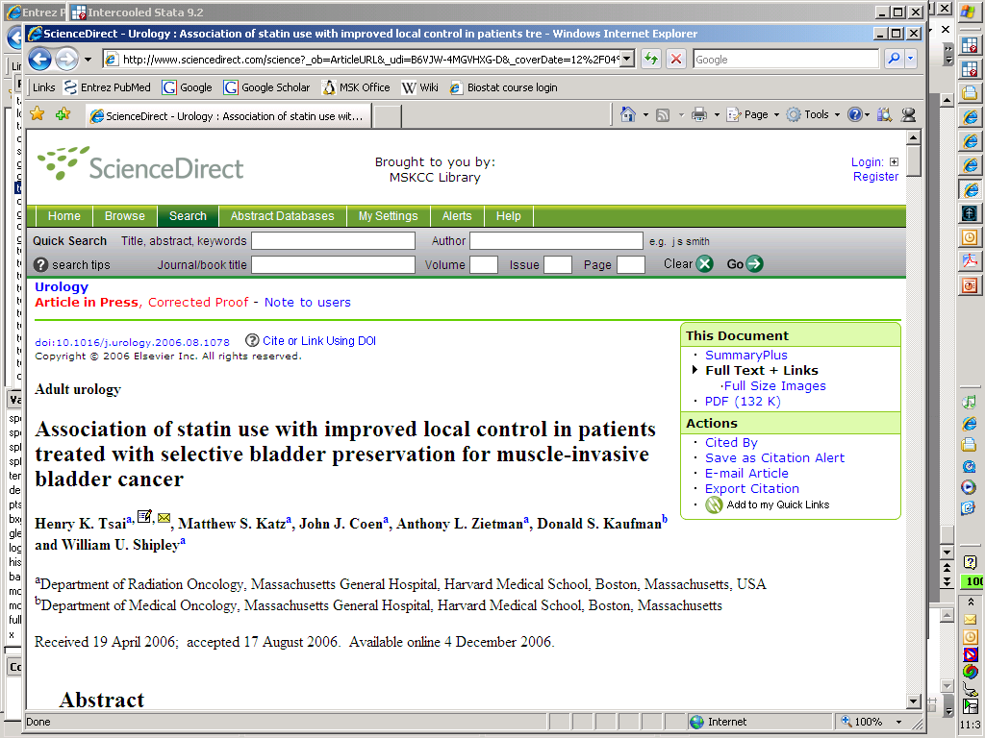

Slide 18
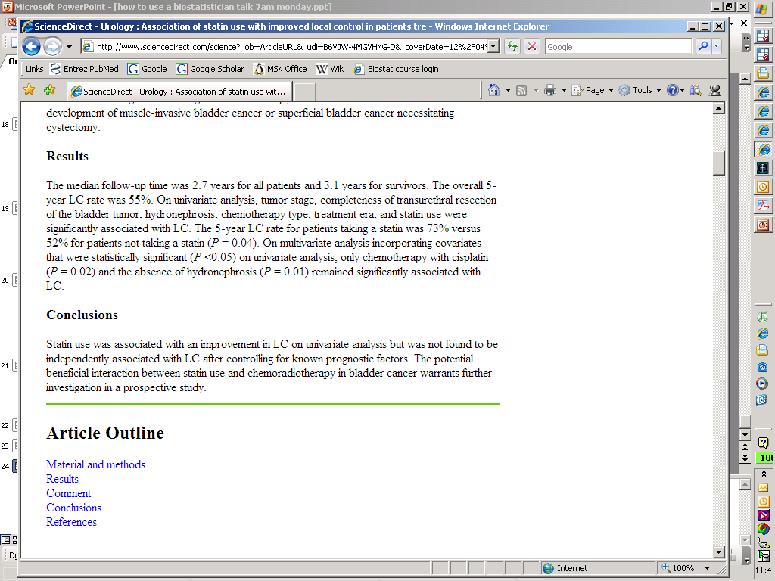

Slide 19

*start with a "table 1" showing characteristics
* we don't want list out all number of positive nodes, cap at 3
replace totalpos=3 if totalpos>3
*no positive nodes if no dissection!
replace totalpos=. if lnd==0
*now create the categorical variable for number of positive nodes
tab totalpos, g(posnoded)
tempfile temp
save `temp'
*print out table 1
forvalues i=1(1)1{
quietly count
disp "Total number of patients&", r(N)
table1 lnd , type(cat) label(Lymph node dissection)
table1 totalnodes if lnd==1, type(con) label(Lymph nodes removed)
disp "Number of positive nodes"
table1 posnoded1 , type(cat) label(0)
table1 posnoded2 , type(cat) label(1)
table1 posnoded3 , type(cat) label(2)
table1 posnoded4 , type(cat) label(3+)
}

Slide 20
g higleason=(bxggscat>6)
g Stage_T2b=clinstagecat>2
*show multivariable model
** type in the rounding: n is how many significant figures
local n=3
*** which type of estimate?
*** answer Odds Ratio, Hazard Ratio or oefficient
local q="Odds Ratio“
***fixed number of decimal places?
***say yes or no
local fixed="yes“
*** say how many places (ignored if "no")
local d=2
** type in the dependent variable for linear or logistic regression
local dep = "lnd“
** type in the name of the predictor variables
local vars = " higleason psa"
local vars = " higleason Stage_T2b psa"
parmby "logistic `dep' `vars'", saving(results, replace)
*

Slide 21
foreach v of local vars {
quietly sum p if parm=="`v'"
local ptemp=r(mean)
if `ptemp'>=.95{
quietly replace pf="p=1" if parm=="`v'"
}
if `ptemp'>=0.2 & `ptemp'<0.95{
quietly replace pf="0"+string(round(`ptemp',.1)) if parm=="`v'"
}
if `ptemp'<0.2 & `ptemp'>=0.1{
quietly replace pf="0"+string(round(`ptemp',.01)) if parm=="`v'"
}
if `ptemp'<0.1 & `ptemp'>=0.001{
quietly replace pf="0"+string(round(`ptemp',.001)) if parm=="`v'"
}
if `ptemp'<0.001& `ptemp'>=0.0005{
quietly replace pf="0"+string(round(`ptemp',.0001)) if parm=="`v'"
}
if `ptemp'<0.0005{
quietly replace pf="<0.0005" if parm=="`v'"
}
}

Slide 22
* establish variables which will contain the appropriate amount of rounding for each predictor
local list = "estimate min95 max95"
foreach l of local list {
g `l'roundd = .
g `l'roundf = .
}
* run this for each predictor
foreach v of local vars {
*this loop searches for how many decimal places are in the value
forvalues i=`n'(-1)-8 {
local decimals=10^(`i'-`n')
*run this for each estimate
foreach l of local list {
quietly sum `l' if parm=="`v'"
local e = r(mean)
if abs(`e') < 10^`i' & abs(`e') >= 10^(`i'-1) { quietly replace `l'roundd =`n'-`i' if parm=="`v'"
}
}
}
}

Slide 23
Result?
Predictor&Odds Ratio&95% C.I.&P Value
Gleason 7+&42.81&16.54, 110.81&<0.0005
Stage_T2b&2.10&0.52, 8.55&0.3
PSA&1.17&1.04, 1.32&0.01

Slide 24
Take home message
Incorporation of biostatistical help is cited by experienced investigators as one of the key determinants of the success or failure of a research program

Slide 25
A quick tour of some assorted statistical slip ups

Slide 26
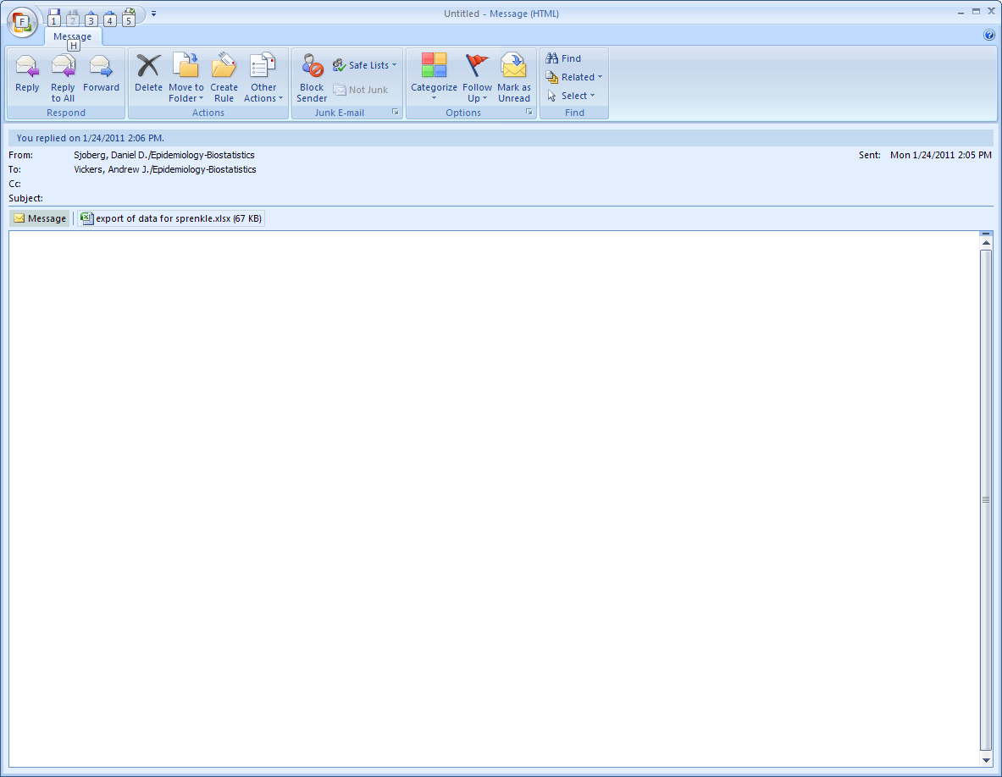

Slide 27
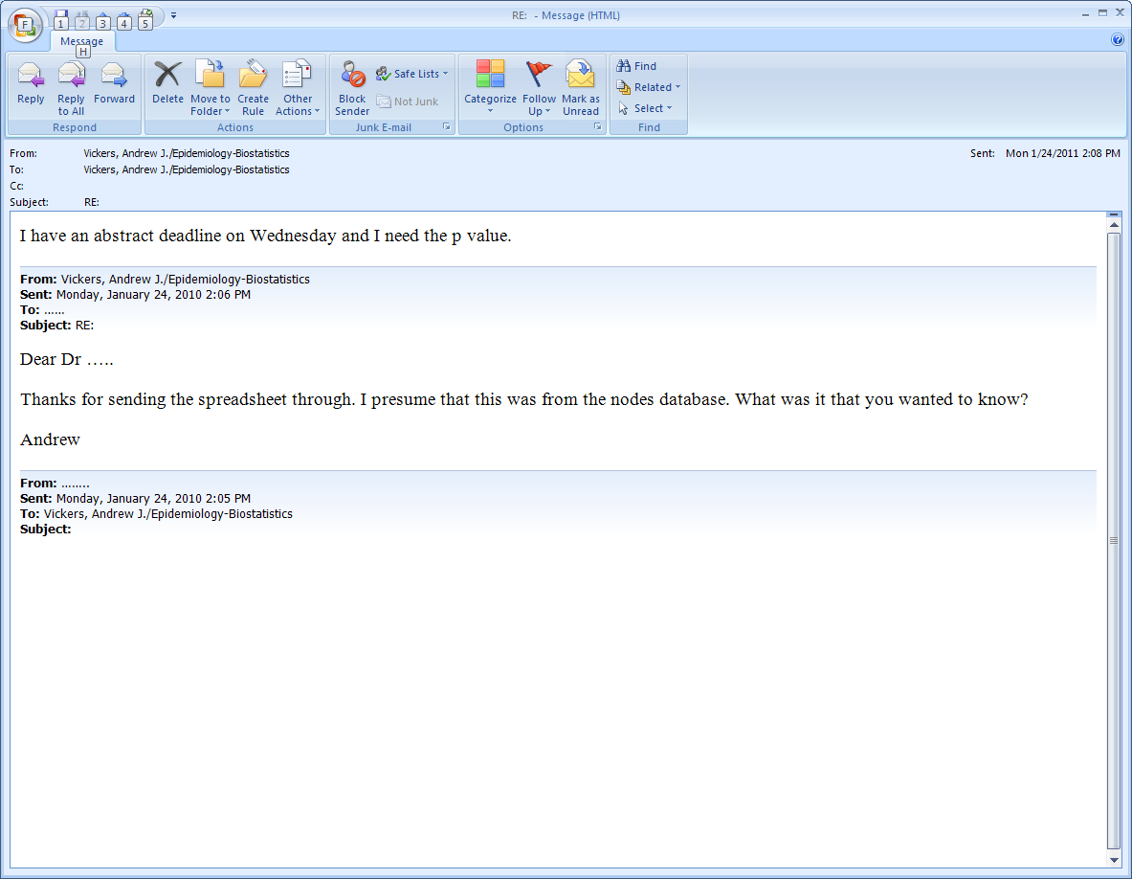

Slide 28
Slip up 1
Statisticians aren’t machines for producing p values

Slide 29
Statistical methods
Inference
  Is something there?
  Hypothesis testing: p values
Estimation
  How big is it?
  E.g. means, correlations, proportions, differences between groups

Slide 30
Statisticians can also help with…
Thinking through the scientific question
Experimental design
Data collection
Data quality assurance

Slide 31
Statistical slip up 2
I shoot hoops with Michael Jordan
He hits 7 of 7 free throws
I hit 3 of 7
P = 0.07 by Fisher’s exact test

Slide 32
Michael Jordan won’t accept the null hypothesis
Conclusion: I got game with Michael Jordan

Slide 33
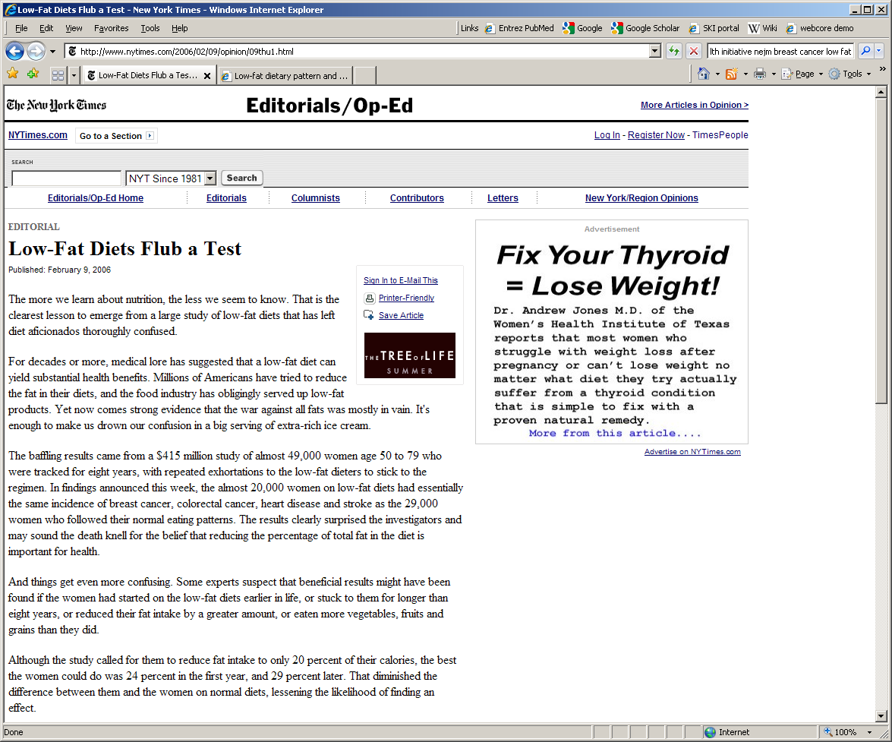

Slide 34
WHI results
10% reduction in breast cancer incidence
P=0.07

Slide 35
Inference 101
State a null hypothesis

Slide 36
Inference 101
State a null hypothesis
Get your data, calculate p value

Slide 37
Inference 101
State a null hypothesis
Get your data, calculate p value
If p<5%, reject null hypothesis
If p ≥5% or more, don’t reject null hypothesis

Slide 38
Statistical slip up 2
Don’t accept the null hypothesis
In a court case: guilty or not guilty
In a statistical test: reject or don’t reject

Slide 39
Statistical slip up 3
There was no correlation between grade and multifocality (r_{s}=0.25, p≤0.09). Each tumor focus volume was significantly correlated with Gleason grade (r_{s}=0.6, p<0.0001). Large tumor foci (> 0.5 cubic centimeters) were significantly less differentiated as compared to small tumor foci (< 0.5 cubic centimeters) (p<0.01). Additionally, large index tumors (≥ 0.5 cubic centimeters) were surrounded by significantly more tumor foci as compared to small index tumors (< 0.5 cubic centimeters) (p=0.02). The ITV and TTV were significantly correlated with the number of tumor foci (r_{s}= 0.46, p=0.004, and r_{s}=0.59, p=0.0001, respectively).

Slide 40
Statistical slip up 4
Twenty (43 percent) cancers were clinically significant. 75 percent of the clinically significant cancers were multifocal, whereas only 36 percent of the clinically insignificant cancers had more than 1 cancer focus (p<0.01). The majority (81.6 percent) of tumor foci were located in the PZ. We found significantly more tumors in the LPZ (45/87) and the MPZ (39/87) than in the CZ (17/87) (p<0.001 and p<0.01, respectively). There was no difference in location between clinically significant and insignificant tumors (p≈1). Prostate cancer was first observed after the age of 40. Before 60 years old, the rate of clinically significant cancer was 1.5 percent, whereas the rate of clinically insignificant cancer was 12 percent (p<0.025).

Slide 41
Statistical slip up 4
Median ITV and TTV increased with age (r_{s}=0.42, p=0.005), as well as Gleason score (r_{s}=0.32, p≤0.05). However, we did not find any correlation between multifocality and age (r_{s}=0.18, p=0.5). MPZ biopsies alone detected 11 (55 percent) of the clinically significant and 3 (11 percent) of the clinically insignificant prostate cancers, whereas MPZ plus LPZ biopsies together detected 16 (80%) and 9 (33%), respectively. The difference was significant (p=0.03 and p=0.01, respectively). The TTV and ITV of prostate cancers detected were significantly higher than those missed (p<0.01.) Detection rate was not significantly different in small versus large prostates (p>0.05). In small prostates, MPZ plus LPZ biopsies detected significantly more cancers than MPZ biopsies alone (p=0.01), the difference was not significant in large prostates .

Slide 42
Statistical slip up 4
 | Prostate cancer detection rates
 | MPZ biopsies | MPZ plus LPZ biopsies | p value
ITV
<0.5 cm³ | 5/34 (15%) | 14/34 (41%) | 0.001
>0.5 cm³ | 9/13 (69%) | 11/13 (85%) | 0.5
Gland volume
≤40 cm³ | 5/17 (30%) | 11/17 (65%) | 0.01
≥60 cm³ | 3/15 (20%) | 6/15 (40%) | >0.1
Age
≤70 years | 5/22 (23%) | 13/22 (59%) | <0.01
>70 years | 9/25 (36%) | 12/25 (48%) | 0.1

Slide 43
Statistical slip up 3
Every single p value tests a hypothesis
Think carefully about every scientific question you want to ask

Slide 44
Statistical slip up 4
RESULTS: Compared with a BMI of 18.5 to 21.9 kg/m2 at age 18 years, the hazard ratio for premature death was 2.79 (CI, 2.04 to 3.81) for a BMI of 30 kg/m2 or greater.
CONCLUSION: Moderately higher adiposity at age 18 years is associated with increased premature death in younger and middle-aged U.S. women

Slide 45
Biostatistics
Biology
Math
Biology

Slide 46
Statistical slip up 4
A result isn’t a conclusion

Slide 47
Statistical slip up 5
Mean gestational time was 36.345 weeks in the experimental compared to 36.229 weeks in controls (p=0.6945).

Slide 48
Statistical slip 5
Every number you write down means something

Slide 49
Statistical slip up 6
Whereas Erk3, ECAD, P21, P53, Cadherin, il 6, il12 and Jak had no association with outcome (p>0.2 for all), Ki67 was a predictor of recurrence (p=0.03). We recommend that Ki67 be measured to determined eligibility for adjuvant chemotherapy.

Slide 50
Statistical fallacy 6
Multiple testing. Looked at 9 different biomarkers. 35% chance of at least one marker with p<0.05.
A statistical association isn’t grounds for a change in practice.

Slide 51
Biggest slip up
Not involving a biostatistician
So what to do about it?

Slide 52
Getting a biostatistician involved
Consultation
  The statistician works on a single paper or protocol as a once-off
Collaboration
  The statistician works with you on all of your projects over many years
Partnership
  The statistician is a key part of the research team and develops scientific ideas

Slide 53
Getting a biostatistician involved
Consultation
  One-night stand
Collaboration
  Going steady
Partnership
  Marriage

Slide 54
Biostatistical consult
(one night stand)
Pros:
  Quick and easy to organize
  You aren’t committing yourself to anything
  You don’t actually have to like the statistician

Slide 55
Biostatistical consult
(one night stand)
Cons:
  Statisticians don’t like it
    (“You just used me and now you won’t even return my calls….”)
  And therefore:
  They don’t necessarily do the greatest job
  Consults go to the bottom of the “to do” pile

Slide 56
In sum
Biostatistical consults
  Fulfill a need
  Are superficial and empty of meaning
  Can leave you feeling hurting and used

Slide 57
Biostatistical collaboration
(going steady)
Pros:
  Makes statisticians happy
  Statisticians understand the scientific and medical context => better science
  Work will get done quicker
  You can get what you need when you want it

Slide 58
Biostatistical collaboration
(going steady)
Cons:
  You have to find someone
    Finding anyone at all
    Finding the right person
  It is expensive (grants / funding)
  You have to listen, change, grow

Slide 59
Biostatistical partnership
… is to collaboration as going steady is to marriage.
It is the same thing, only more so.

Slide 60
Some hints and tips
Recoding data or creating new variables
  Length of survival
  Stage / grade in two or three categories
  Nomogram predicted probability
  Creating a risk group

Slide 61
Recoding data / creating new variables
Check that you have to
  Study database may have the information
Do not do manually
If you have to use Excel
  Keep the formula!
  Don’t cut and paste values
Ideally
  Use statistical software
  Ask the statisticians

Slide 62
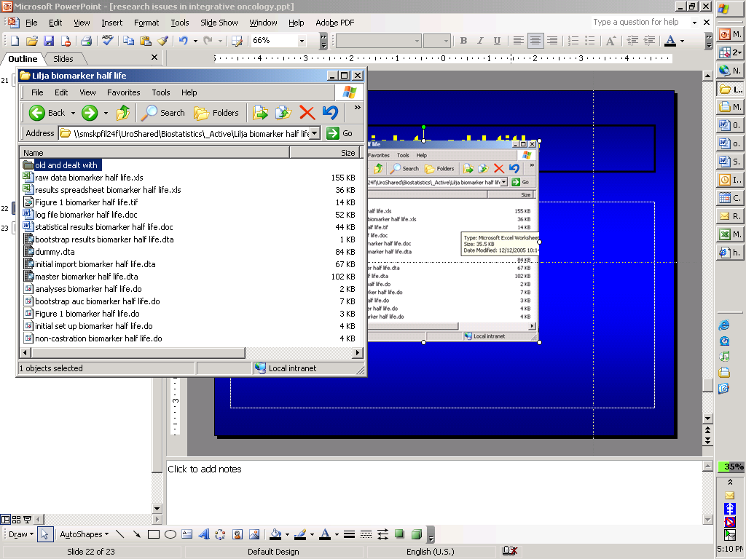

Slide 63
Data checks
Consider every possibility for:
  Illogical data
    Last day of follow-up before surgery; ftpsa ≠fpsa / tpsa
  Range checks
    Pre-surgery PSA > 100; Stage “T1xb”
  Missing data
  Clinical impression
    Number of non-disease related deaths
    Length of follow-up
    Stage and grade distribution

Slide 64
Data merging
From study database
  List of MRNs and survival data
From the lab
  List of MRNs and biomarker values
Sort by MRN on Excel and line up columns?

Slide 65
Data merging
Only attempt by using statistical or database software that
  Guarantees matching
  Identifies missing matches
  Documents the merging process

Slide 66
Exam will be posted on the class website in the next 48 hours
4 questions; couple of hours; 2 week deadline.
Questions are far easier than the typical statistical problems you are likely to encounter in real research.
I mark very liberally
Low pass mark (50%)
Anyone who fails the exam is given an opportunity to resubmit

Slide 67
Emailing answers around
Secondary endpoints include quality of life and relapse at six months …. The data for quality of life is not normally distributed for both [groups]
The secondary endpoints included quality of life and relapse at 6 months …. The QOL data are not normally distributed for either [group]

Slide 68
Working in groups
I am perfectly happy for you to work in small groups as long as:
  You are clear and explicit about this up front
  All members of a group contribute equally
  You don’t take advantage

